Slide 1
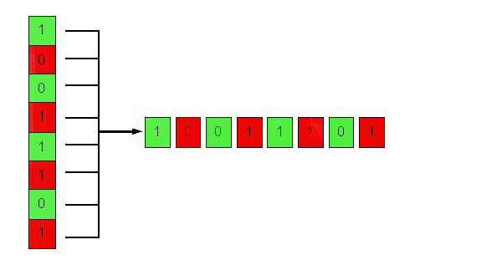
Serial Interfaces, Part Deux
I²C and SPI
December 4, 2002
Presented by Eugene Ho

Slide 2
Introduction
I²C and SPI
Serial communication protocols
Meant for short distances “inside the box”
Low complexity
Low cost
Low speed ( a few Mbps at the fastest )
To be discussed: Applications, protocols, tradeoffs, AVR support

Slide 3
What is I²C?
Shorthand for an “Inter-integrated circuit” bus
Developed by Philips Semiconductor for TV sets in the 1980’s
I²C devices include EEPROMs, thermal sensors, and real-time clocks
Used as a control interface to signal processing devices that have separate data interfaces, e.g. RF tuners, video decoders and encoders, and audio processors.
I²C bus has three speeds:
  Slow (under 100 Kbps)
  Fast (400 Kbps)
  High-speed (3.4 Mbps) – I²C v.2.0
Limited to about 10 feet for moderate speeds

Slide 4
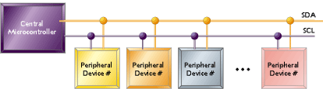
I²C Bus Configuration
2-wire serial bus – Serial data (SDA) and Serial clock (SCL)
Half-duplex, synchronous, multi-master bus
No chip select or arbitration logic required
Lines pulled high via resistors, pulled down via open-drain drivers (wired-AND)

Slide 5

I²C Protocol
1. Master sends start condition (S) and controls the clock signal
2. Master sends a unique 7-bit slave device address
3. Master sends read/write bit (R/W) – 0 - slave receive, 1 - slave transmit
4. Receiver sends acknowledge bit (ACK)
5. Transmitter (slave or master) transmits 1 byte of data

Slide 6
I²C Protocol (cont.)
6. Receiver issues an ACK bit for the byte received
7. Repeat 5 and 6 if more bytes need to be transmitted.
8.a) For write transaction (master transmitting), master issues stop condition (P) after last byte of data.
8.b) For read transaction (master receiving), master does not acknowledge final byte, just issues stop condition (P) to tell the slave the transmission is done

Slide 7
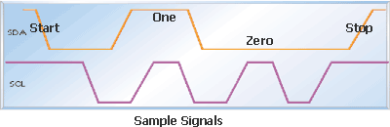
I²C Signals
Start – high-to-low transition of the SDA line while SCL line is high
Stop – low-to-high transition of the SDA line while SCL line is high
Ack – receiver pulls SDA low while transmitter allows it to float high
Data – transition takes place while SCL is slow, valid while SCL is high

Slide 8
I²C Features
“Clock stretching” – when the slave (receiver) needs more time to process a bit, it can pull SCL low. The master waits until the slave has released SCL before sending the next bit.
“General call” broadcast – addresses every device on the bus
10-bit extended addressing for new designs. 7-bit addresses all exhausted

Slide 9
AVR Support for I²C
Atmel calls it “Two-wire Serial Interface” (or TWI)
Supported by all AVR 8-bit μC except ATTiny and AT90
ATmega323 TWI mode when TWEN in TWCR is set:
PC0=SCL, PC1=SDA
TWBR – sets bit rate
TWCR – controls start, stop, ack generation, indicates M/S, T/R
TWDR – contains byte transmitted/received
TWAR – contains slave address
TWSR – indicates status of TWI Bus (start condition
transmitted, ACK received, … 26 total states)

Slide 10
I²C Tradeoffs
Advantages:
Good for communication with on-board devices that are accessed occasionally.
Easy to link multiple devices because of addressing scheme
Cost and complexity do not scale up with the number of devices
Disadvantages:
The complexity of supporting software components can be higher than that of competing schemes ( for example, SPI ).

Slide 11
What is SPI?
Shorthand for “Serial Peripheral Interface”
Defined by Motorola on the MC68HCxx line of microcontrollers
Generally faster than I²C, capable of several Mbps
Applications:
Like I²C, used in EEPROM, Flash, and real time clocks
Better suited for “data streams”, i.e. ADC converters
Full duplex capability, i.e. communication between a codec and digital signal processor

Slide 12

SPI Bus Configuration
Synchronous serial data link operating at full duplex
Master/slave relationship
2 data signals:
  MOSI – master data output, slave data input
  MISO – master data input, slave data output
2 control signals:
  SCLK – clock
  /SS – slave select (no addressing)

Slide 13
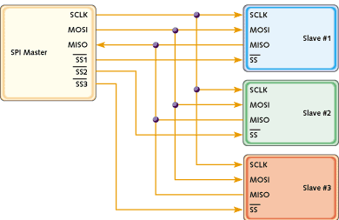
SPI vs. I²C
For point-to-point, SPI is simple and efficient
  Less overhead than I²C due to lack of addressing, plus SPI is full duplex.
For multiple slaves, each slave needs separate slave select signal
  More effort and more hardware than I²C

Slide 14
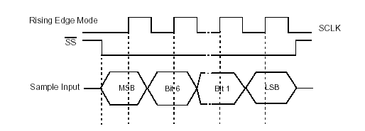
SPI Protocol
2 Parameters, Clock Polarity (CPOL) and Clock Phase (CPHA), determine the active edge of the clock
Master and slave must agree on parameter pair values in order to communicate
CPOL | CPHA | Active edge
0 | 0 | Rising
0 | 1 | Falling
1 | 0 | Falling
1 | 1 | Rising

Slide 15
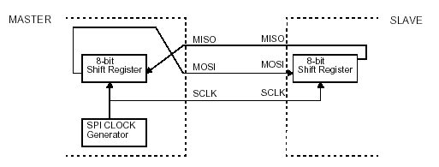
SPI Protocol (cont.)
SPI interface defines only the communication lines and the clock edge
There is no specified flow control! No acknowledgement mechanism to confirm receipt of data
Hardware realization is usually done with a simple shift register

Slide 16
AVR Support for SPI
Supported by all AVR 8-bit μC except ATTiny and some AT90s
ATmega323 - SPI mode when SPE bit in SPCR is set:
PB6=MISO, PB5=MOSI, PB7=SCK, PB4=/SS
SPCR – sets bit rate, CPOL, CPHA, M/S
SPDR – used for data transfer to and from SPI shift register
For multiple slaves, must employ “bit-banging”. Use software to control serial communication at general-purpose I/O pins.

Slide 17
Summary
I²C and SPI provide good support for communication with slow peripheral devices that are accessed intermittently, mainly EEPROMs and real-time clocks
I²C easily accommodates multiple devices on a single bus.
SPI is faster, but gets complicated when there is more than one slave involved.

Slide 18
References
I²C:
http://www-us2.semiconductors.philips.com/acrobat/various/
I2C_BUS_SPECIFICATION_1995.pdf
http://www.esacademy.com/faq/i2c/index.htm
http://www.embedded.com/story/OEG20020528S0057
SPI:
MC68HC11 manual
http://www.mct.net/faq/spi.html
http://links.epanorama.net/links/serialbus.html
http://www.embedded.com/story/OEG20020124S0116

